Slide 1
Sterilization
University of Basrah/Veterinary medicine Collage
Dep. Of Veterinary Surgery and Obstetric
Dr. Alaa A. Ibrahim

Slide 2
Sterilization :- is the process of destroying of all microorganism (bacteria, viruses, fungi , and prions) in or on an object .Sterilization can occur through physical or chemical means
Antiseptic :- is the substances that stop or slow down the growth of microorganism on living objects
Disinfection:- is the process that eliminates many or all pathogenic microorganisms (except bacterial spores ) on inanimate objects.

Slide 3
Types of disinfectants
High-level disinfectant:- are those that kill any microorganisms present, with the exception of large numbers of bacterial spores (e.g., 20 minutes for 2% Glutaraldehyde).
Intermediate-level disinfectants :- Typically will not kill bacterial spores but kill mycobacteria, vegetative bacteria, most viruses, and most fungi
Low- level disinfectants : can kill most vegetative bacteria, some fungi, and some viruses in a practical period of time

Slide 4
Equipments (Items )
Critical equipment :- are those associated with high risk of infection when they become contaminated .These includes items such as surgical instruments, catheters, needles, and
implants, all of which should be sterilized
Semi-critical items :- are those that come in contact with mucous membranes or skin, such as laryngoscopes and esophageal probes. These items should be subjected to sterilization or high-level disinfection
Noncritical items:- are those that contact only skin, such as stethoscopes and gurneys(نقالات). These items can be disinfected with low-level disinfectants

Slide 5
Types of Sterilization
Liquid chemical germicides (cold sterilization )
Soaking instruments or other equipment in a disinfectant (frequently a liquid )
Decrease the ability to access microbes in the interior or crevices when compared with thermal sterilization
Their used is limited
Most chemical liquid sterilants do not have an appropriate biologic sterility indicator
not advised for surgical equipment or other items that, if contaminated, would carry the risk of highly significant sequelae
Use with endoscopic equipment

Slide 6
Liquid chemical germicides (cold sterilization )
Glutaraldehyde, one of the most frequently used chemical sterilants, has reasonable efficacy against bacterial spores, but only with prolonged exposure
Glutaraldehyde is considered a high-level disinfectant but is too expensive to be used on noncritical items and irritating to the respiratory passages
Formaldehyde is available as a 37% aqueous solution (formalin). It is slightly less efficacious than glutaraldehyde and is considered a carcinogen(poor candidate for most clinical application
Hydrogen peroxide (producing hydroxyl free radicals to interfere with membranes and nucleic acids) can be used as chemical sterilants but must be store in dark container to prevent loss of efficacy and also can be consider toxic to mucous membranes and can discolor some metals .

Slide 7
Steam sterilization
the most common method
preferred method for items that are heat and moisture stable
operate under a balance of steam, pressure, temperature, and time
kill microorganism through coagulation and denaturation of proteins by moist heat .
inexpensive, efficacious (including against spores), nontoxic, and rapidly effective with a variety of materials

Slide 8
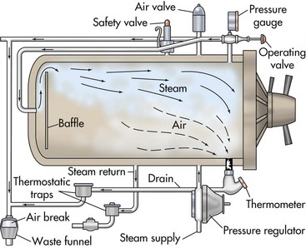
Autoclaves
Gravity-displacement sterilizer
is the most common autoclave used in
veterinary practice (typical temperature 121⁰C for 30 minutes )
steam introduced under pressure, being lighter than air, stays at the top and forces air out through a valve at the bottom .

Slide 9
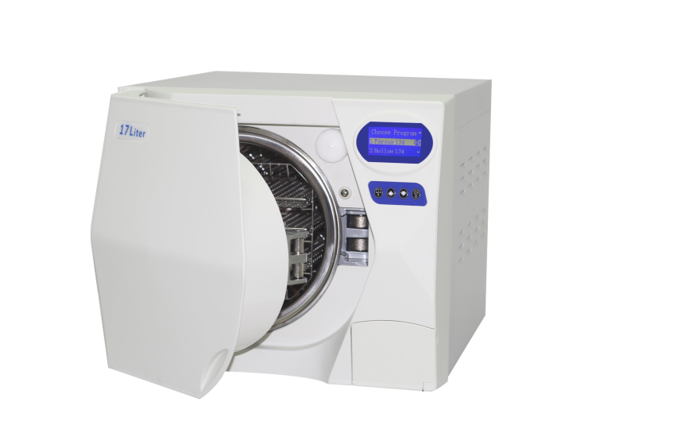
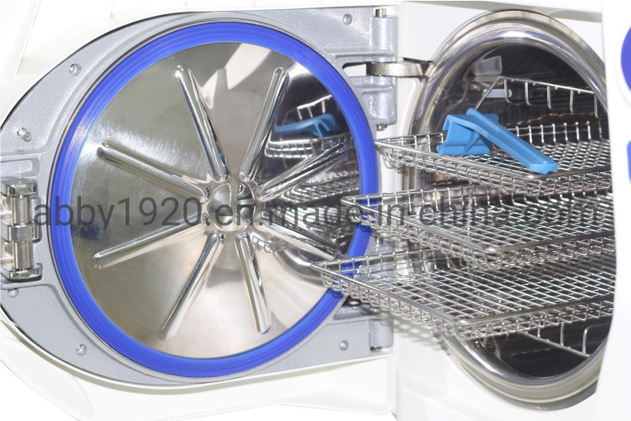
Autoclaves
Prevacuum steam sterilizer
its function is similar to gravity-displacement sterilizer with the exception that a pump is used to remove air before the steam is admitted and typical temperature 134⁰C for 4 minutes. This allows for very rapid and uniform steam distribution within the chamber.

Slide 10
low-temperature steam formaldehyde sterilization
involves the introduction of formaldehyde vapor and saturated steam into a prevacuum chamber
The temperature is maintained at between 65- 80 before the system is purged with air.

Slide 11
Flash sterilization
Rapidly sterilizing items that are needed for immediate use and therefore cannot be subjected to the normal protocol
involves a steam autoclave that is programmed to use a higher temperature and a shorter time cycle
General guidelines for flash sterilization of metallic nonporous (no lumens) items in a gravity-displacement autoclave include 3 minutes of exposure time at 135° C with 1 minute of drying time

Slide 12
Ethylene oxide(EtO) sterilization:-
Is low- temperature sterilization method involve using of ethylene oxide gas
(EtO)is colorless and odorless and has boiling point of 10.5°C.
mode of action is by alkylation of protein and nucleic acid thereby obstructing cell metabolism and reproduction
used for items that cannot be sterilized by steam sterilization.
EtO is flammable( so it usually mixed with carbon dioxide orhydrochloroflourocarbone) ,toxic , carcinogenic, mutagenic, and neurologic hazard .So EtO use will likely decrease because of these disadvantages.

Slide 13
Ozone sterilization :-
used for heat-sensitive items
Ozone is generated from oxygen and water during sterilization cycle and then converted back to nontoxic compounds .
the ozone molecules (O3) is contain loosely bound third oxygen molecule which readily oxidizes other molecules to cause destruction of microorganism.
Ozone sterilization is not suitable for paper , wood, and packaging .

Slide 14
Plasma sterilization :-
Plasma sterilizer use electromagnetic energy to create a plasma phase from a vapor of hydrogen peroxide, oxygen, or peracetic acid/hydrogen peroxide mixture.
The plasma contains reactive products such as free radicals that deactivate cellular processes
Plasma sterilizers are rapid and effective, but high cost may be a concern
useful for moisture- or heat sensitive items but should not be used for linens, liquids, or wood products

Slide 15
Sterilization by radiation :-
Gamma irradiation is also used to sterilize surgical items
Their use is limited (expensive )
Items such as suture and certain implants are often sterilized by radiation.

Slide 16
Indictors of sterilization
Sterilization monitors are used to evaluate the efficacy of the sterilization process
These monitors may be physical , chemical , or biological monitors.
Physical monitors are associated with specific sterilization unit
Chemical monitors react to specific parameters that are critical for sterilization typically by color change.

Slide 17
Chemical monitors are divided into six classes:-
Class 1indicator such as sterilization tape applied to the outside of a surgical pack indicates that the pack has been processed
Class 2 indicator test for air removal and is known as Bowie-Dick test
Class 3 indicator react to specific parameters such as temperature or time
Class 4 indicators react to more than one parameters
Class 5 indicators react to all parameters that are important to a given type of sterilization .Class 5 indicator placed in the deepest portion of the pack.
Class 6 indicators, the newest class, have been designed to monitor more specific guidelines associated with a unique indication such as the parameters required to combat prion infection, or those associated with particular instrument.

Slide 18
Biological indicator
is the best method of determining is the sterilization protocol being followed is effective
This test consist of culturing microorganism that evaluated post processing to determine viability
Typical biologic indictors require 16 hours to 7 days of incubation.
Some biologic indicators can be evaluated in 1 hour; these are termed rapid-action indicators

